Slide 1
Collective Behaviour
Simulating Schooling Fish Feeding Behaviour
Ana Gelez | Sarah Gay | Mélinda Fabien |
Alina Sereda

Slide 2
01
Introduction

Slide 3
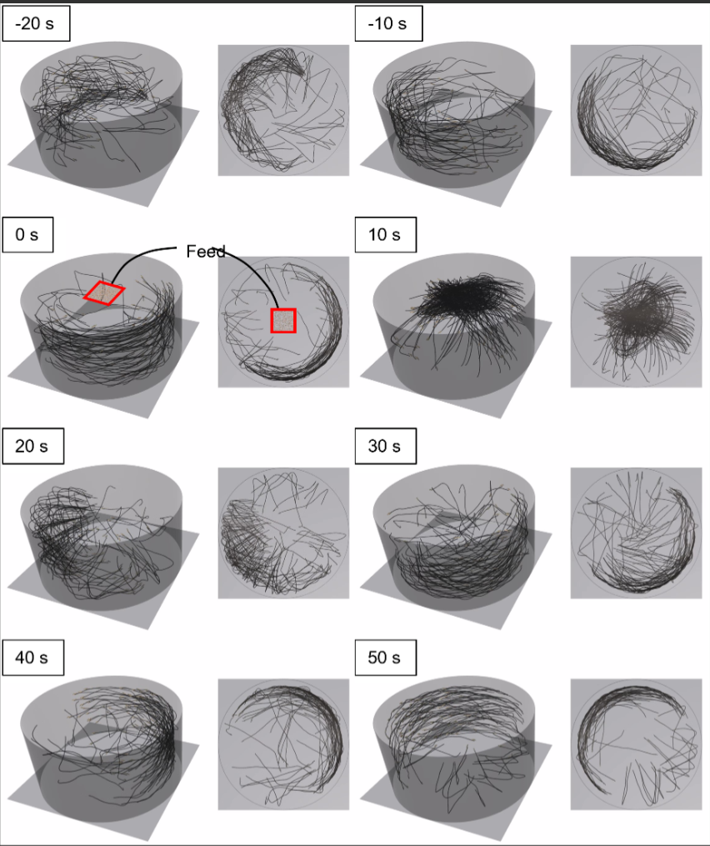
Introduction
It can be challenging to estimate best living conditions for fish in aquaculture since tests may harm animals.
Our work is based on an interesting paper which tested three feeding distribution sizes by simulating a fish tank.
We extended it by adding three more shape of distribution zones to know if there were more optimized configurations.
Visualization of the paper we extended

Slide 4
02
Methods
How did we implement our solution ?

Slide 5
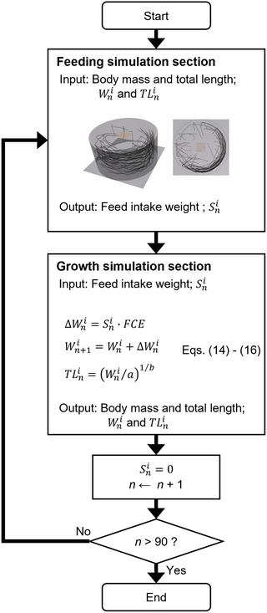
How the simulation works ?
Main characteristics :
Software : Godot with GDScript
Tank : 3 m diameter and 1.5 meter depth
Two main phases for 100 individuals :
Feeding (~ 10s)
Growth (~ 50s)
Duration : 90 days

Slide 6

Movement model of the fish
Fish behaviour
Separation
Alignment
Cohesion
Approach towards food
Boundary avoidance
Random movement

Slide 7
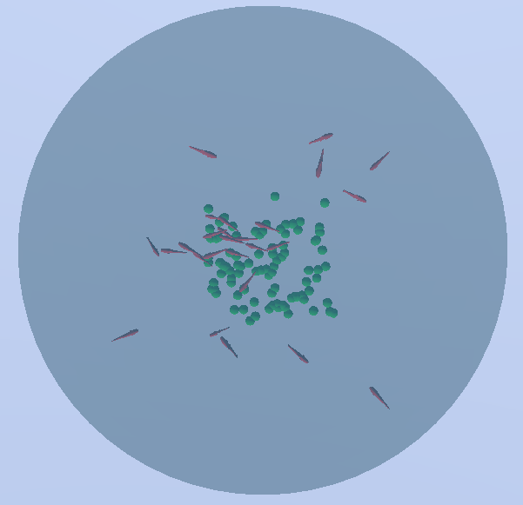
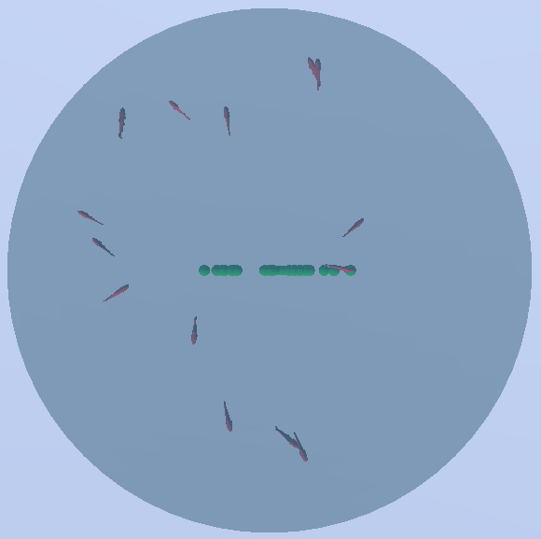
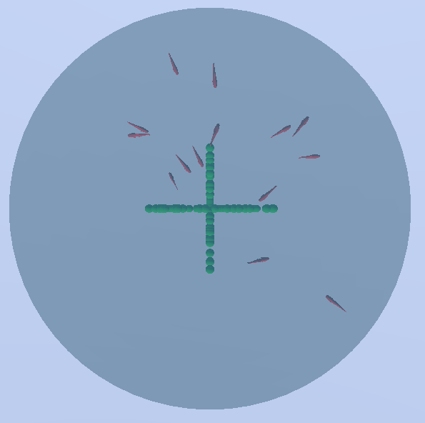
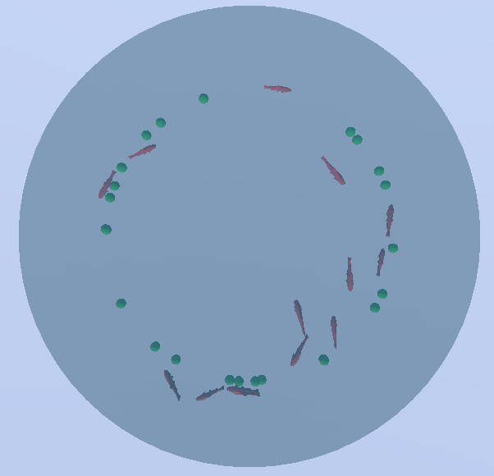
Feeding simulation
Food is drop in the tank everyday in a zone chosen beforehand :
Square shaped
Line shape
Cross shape
Circle shape
Each zone has three possible sizes :
0.5m
1m
1.5m
Illustration of food areas (in green) for a size of 1.5m

Slide 8
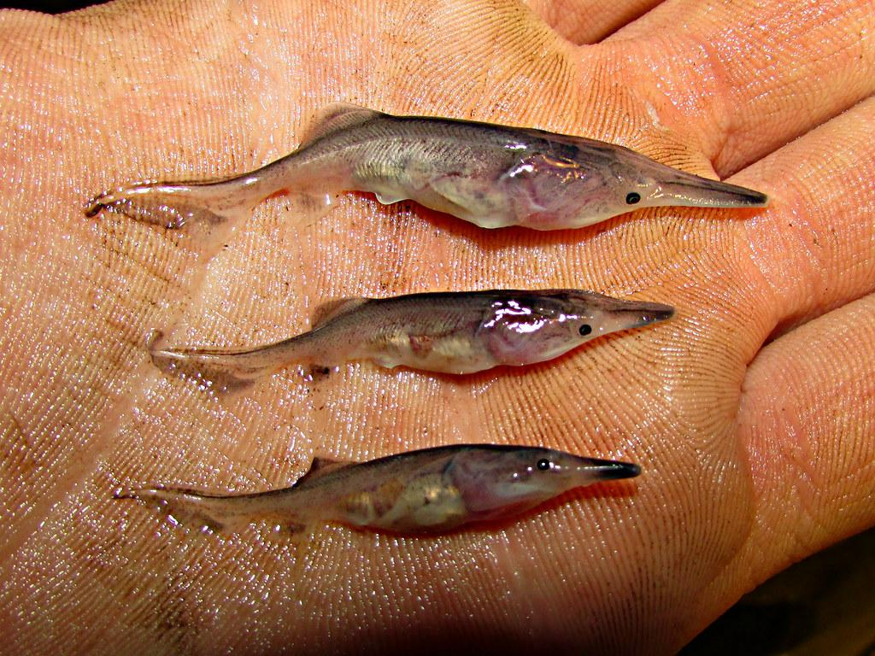
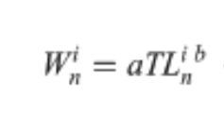
Growth simulation
Depending on the quantity of food ingested by the fish in the feeding phase, it will
experience varying degrees of growth. It’s calculated thanks to allometric equation and FCE :

Slide 9
03
Results
Explanation and comparison of the results

Slide 10
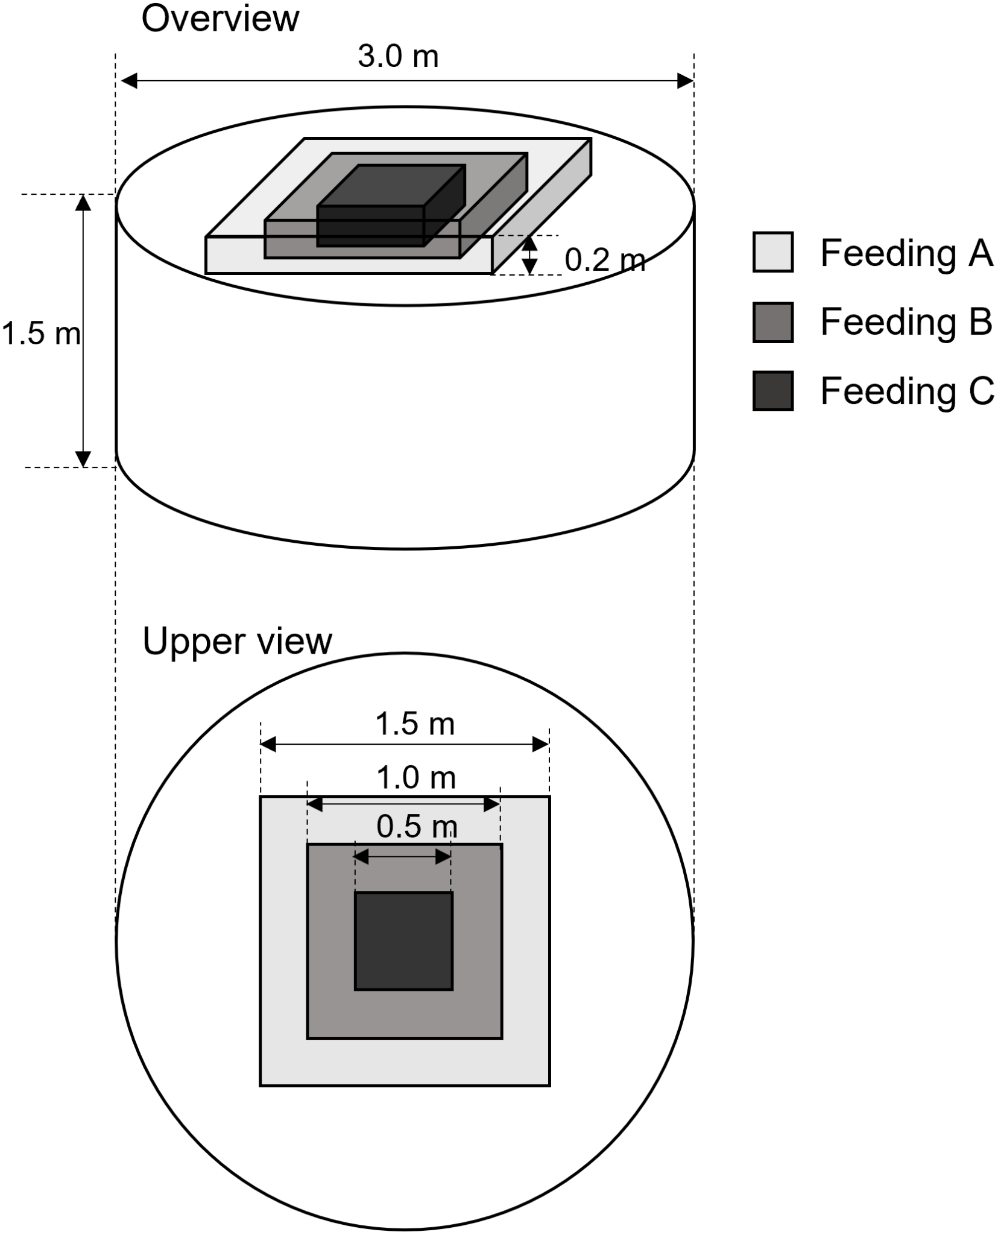
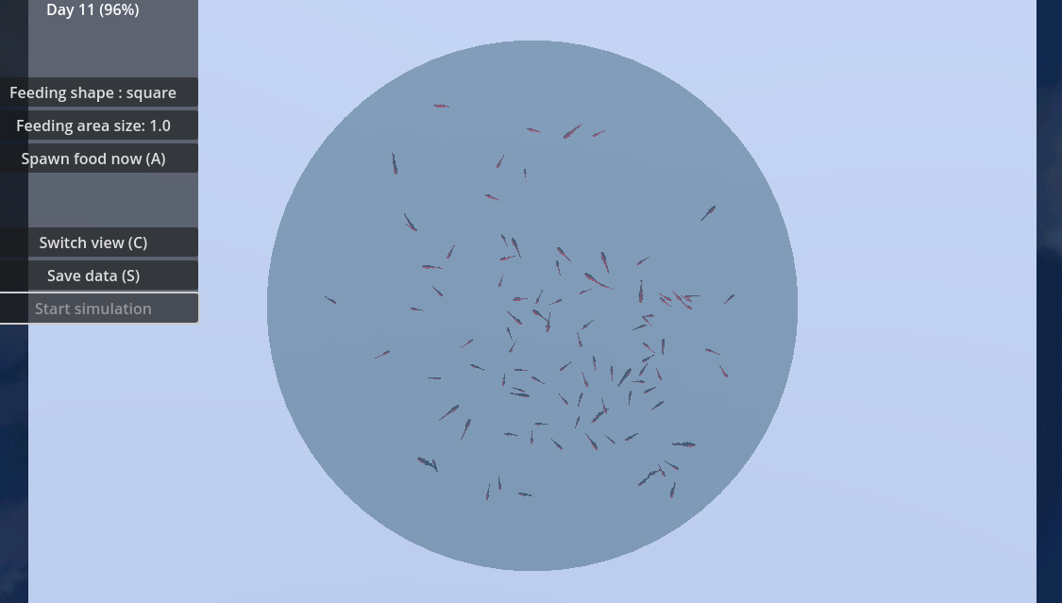
First Test explication
Testing of three types of square feeding distributions :
Feeding A : diameter 0.5m
Feeding B : diameter 1m
Feeding C : diameter 1.5m

Slide 11
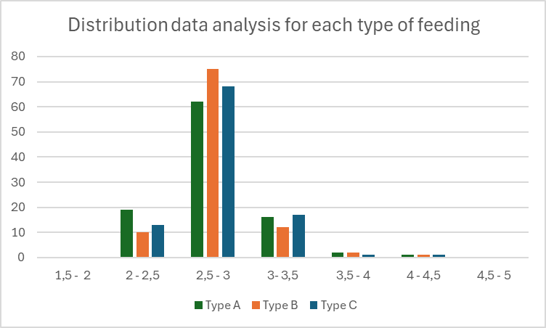

First Test Results
‘’Consequently, the difference in total body mass among the three feeding methods was not significant regardless of the feeding area. ’’

Slide 12
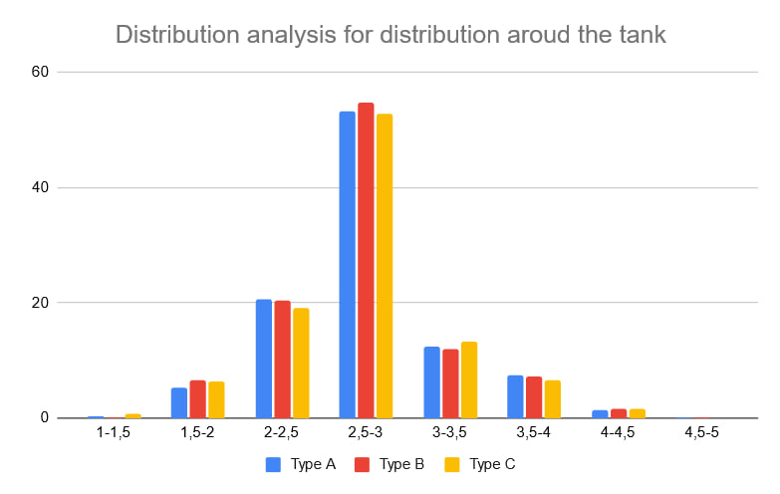
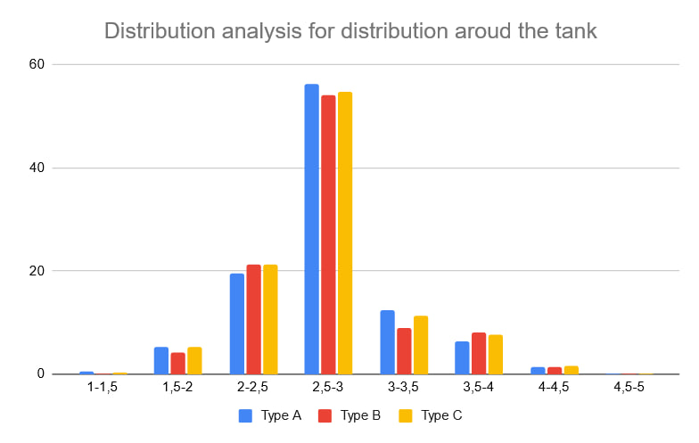
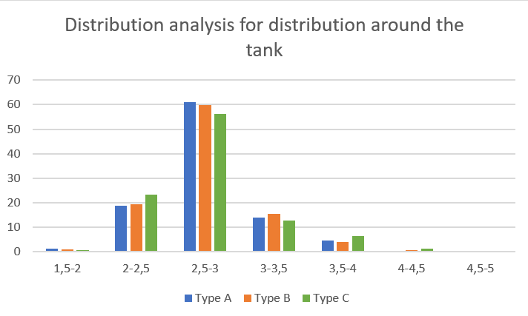
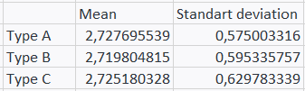
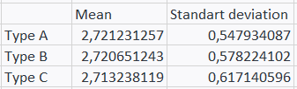
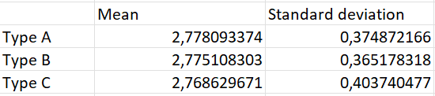
Extension test results
Line shape
Cross shape
Circle shape

Slide 13
04
Discussions

Slide 14
Discussions
Two different fish populations
Replace FCE?
Naive approach to fish growth
DEB is an alternative model
One with little variance
The other with both big and small fishes
Both could be useful depending on what we want

Slide 15
Conclusion
We reproduced the results from the paper by re-implementing it with Godot
We added new ways of feeding fishes
It allowed us to discover a way to have fishes of more similar sizes

Slide 16
Thanks!
Do you have any questions?

